Slide 1
Open Data re-use – what are businesses doing with Open Data

Slide 2

Open Data matters because it represent value for businesses, citizens and public administrations
27.3%
Top 3 Open Data domains re-used most
Clear popularity of three types of Open Data domains
Domains expected to have the highest economic impact
More data on companies requested most
25.8%
19.5%
Geospatial
Statistical
Companies
Regions & Cities
Top 4 combinations of Open Data categories
Regions & Cities data is often combined with the other 3 categories
On average companies use 5 categories of Open Data
36% of the companies aggregate the data, regardless of its nature
St
Transport
Population & Societiy
Environment

Slide 3




How is the Open Data being re-used? Examples from the field
Regions & Cities
SmartAppCity brings together all the Open Data of a city in 1 application, offering all information for citizens & tourists
Population & Society
Fluicity offers a platform for citizens to communicate with their local politicians and administrations, stimulating direct democracy. The Open Data created on the platform is analysed & shared with the city.
Transport
Open Move developed a platform importing Open Data from a city to become a mobile ticketing application. Via this application citizens buy the tickets they need, operators have the tools to control tickets and local businesses can offer tailored promotions.
Environment
Normative analyses business transactions on their environmental impact using Open Data to automatically create sustainability reports for big companies.

Slide 4
Businesses see Open Data leading to innovation and efficiency as well as a source of revenue
Selling services most important source of revenue
Nearly half of the Open Data re-use is for selling services
34% of these services are based on software
25 of these services are consulting
Main benefits of working with Open Data
47%
Innovation
26%
Reduced costs and increased efficiency
15%
Sources of revenue
Data harmonisation
42%
6%
21%
Enhanced business model
10%
6%
Reliability
0%
10%
20%
30%
40%
50%
Selling products
& services
Selling services
Selling products
Frequency
Notes:
The emergence of Data Brokers
To become useful, data needs to be collected and cleaned
Most companies are working on the collection and aggregation of Open Data
Creating a new position as data broker

Slide 5

Business is developing at all stages of the Open Data value chain
Respondents as their Open Data Value Chain archetype
The emergence of Data Brokers
To become useful, data needs to be collected and cleaned
Most companies are working on the collection and aggregation of Open Data
Creating a new position as data broker
Enricher
Use Open Data to enhance existing products or services
Supplier
Provide Open Data
Enablers
Mostly facilitate the supply or use of Open Data instead of using it themselves
Developers
Use Open Data primarily for the development of applications
Use Open Data to gather meaningful insights
Aggregator
Aggregation, analysis and development of new services - an example
Using Open Data can help build real estate data indicators
segmented mirco located data
Enabling comparisons and further data aggregation
People
Economics
Move
Shape
System
Environment

Slide 6
Re-users are looking for quality and continuity
My company is...
12,2%
relying on data from a specific organisation
16,9%
relying on real-time data
27,3%
relying on quality data
12,8%
relying on a specific dataset
25,6%
relying on the systematic and continued publication of specific data sets
5,23%
not using data as a critical business source
5%
10%
15%
20%
25%
30%
Times mentioned (in percentages)
The systematic and continued publication of quality Open Data is essential for re-users, and to a lesser extent real-time data

Slide 7
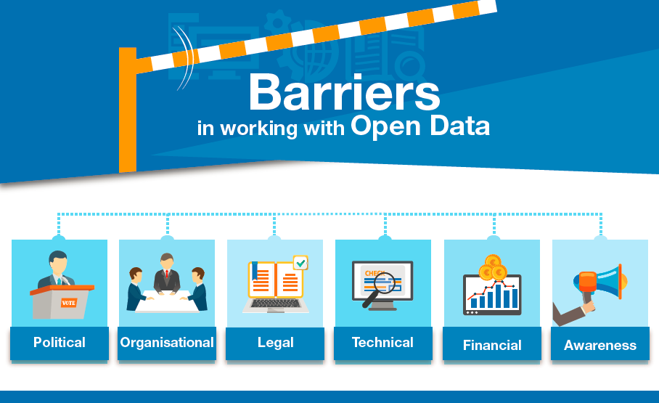

Slide 8
Barriers hinder the Open Data community to reap the full potential of the re-use of Open Data
Heterogeneity
Quality
Metadata
Availability
Of formats, standards and structures
In detail and completeness
In correctness and standardisation
In discovering and accessing the data
Awareness
On the specific needs of re-users, and on the availability of Open Data
Hindering the development of automated processes
Making the data less of interest
Creating the stringent need to control
Creating available yet unused datasets
Creating a mismatch between the re-users and providers
Open Data catalyses growth
37% expect to see their turnover to grow by 61% or more
For 30% of the companies Open Data accounts for 11-95% of turnover
Open Data can also drive cost savings
1.7 Bn EUR of cost savings for European public administrations by 2020
Despite the growing popularity of data portals, 25% of businesses still adresses administrations directly

Slide 9
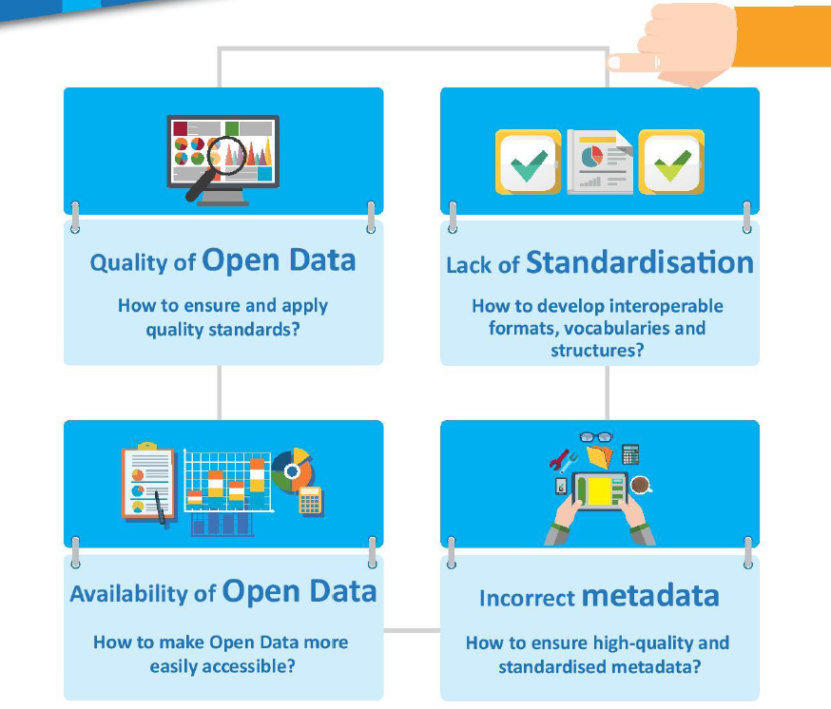
But barriers persist, preventing companies to reap the full benefit of Open Data
X
Notes:
The low quality of Open Data was perceived both in the data itself as well as in the accompanying metadata. In both cases, respondents recurrently mentioned examples of Open Data they found in which either the indicators used within the set or the metadata describing the set did not correctly represent the data.
Heterogeneity - a lack of standardisation of the data, for instance in format, variety in platforms to access data or low consistency over time - restricts the opportunity for users to develop permanent solutions to overcome these types of barriers.
Another frequently mentioned barrier is a poor discoverability of the exact type of Open Data users are looking for, a barrier which is related to the aforementioned low levels of quality in the descriptions of the sets and plurality of platforms
Incorrect metadata – often not clear where the dataset is about, if metadata is available at all. Or not clear how often the dataset is updated, which is a problem when re-users need to rely on periodically updated data.

Slide 10
Barriers for Open Data publishers and re-users
Main barriers for publishers:
Financial: main barrier for 71% of EU countries
Legal: 2nd most important barrier for 58%
Technical: 3rd barrier for 52%
Political: 4th barrier for 45%
Other, such as organisational barriers and lack of awareness
Main barriers for re-users:
Lack of awareness: main barrier for 68%
Low availability: 2nd most important for 42%
Technical: 3rd barrier for 32%
Legal: 4th barrier for 26%
Financial: 5th barrier for 19%
Other, such as political barriers
Copyright EDP CC BY
Notes:
financial barrier is the most important barrier, mentioned by 71% of the countries. This barrier refers to the funding needed to deploy Open Data activities such as managing an Open Data Portal.

Slide 11
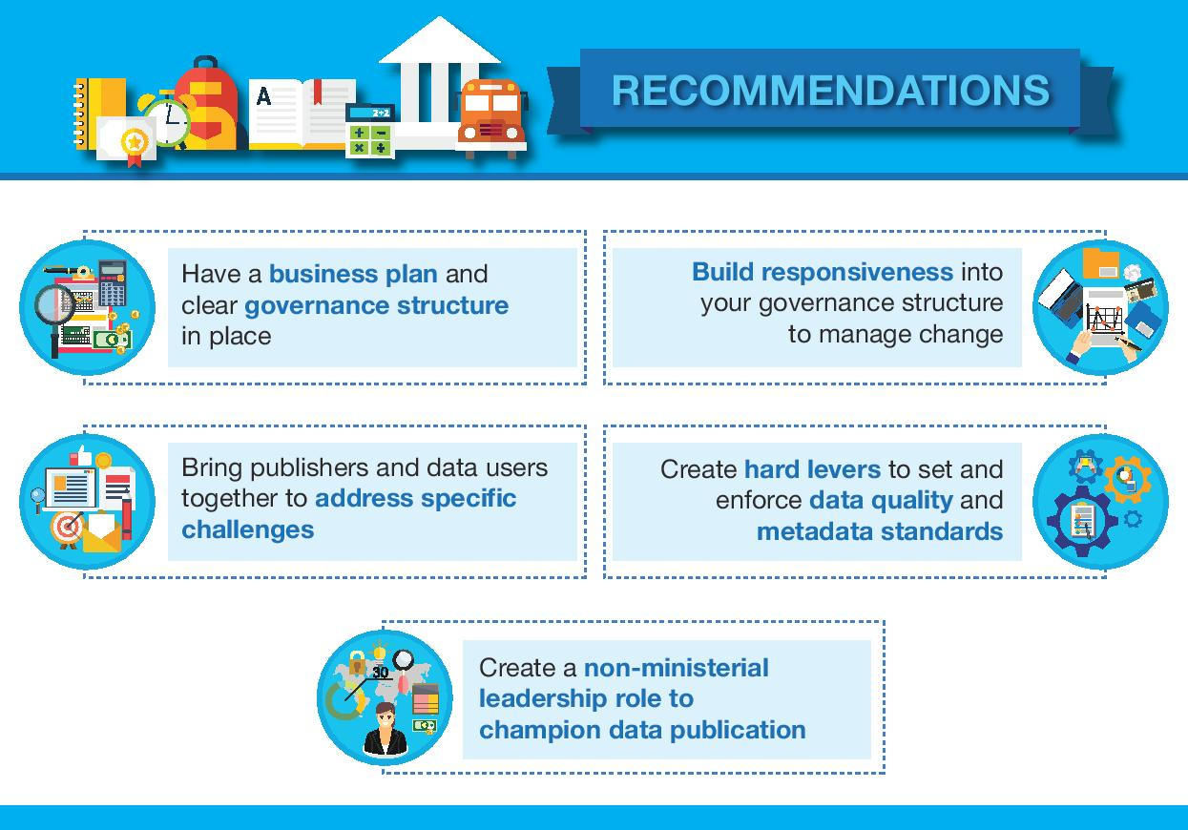

Slide 12
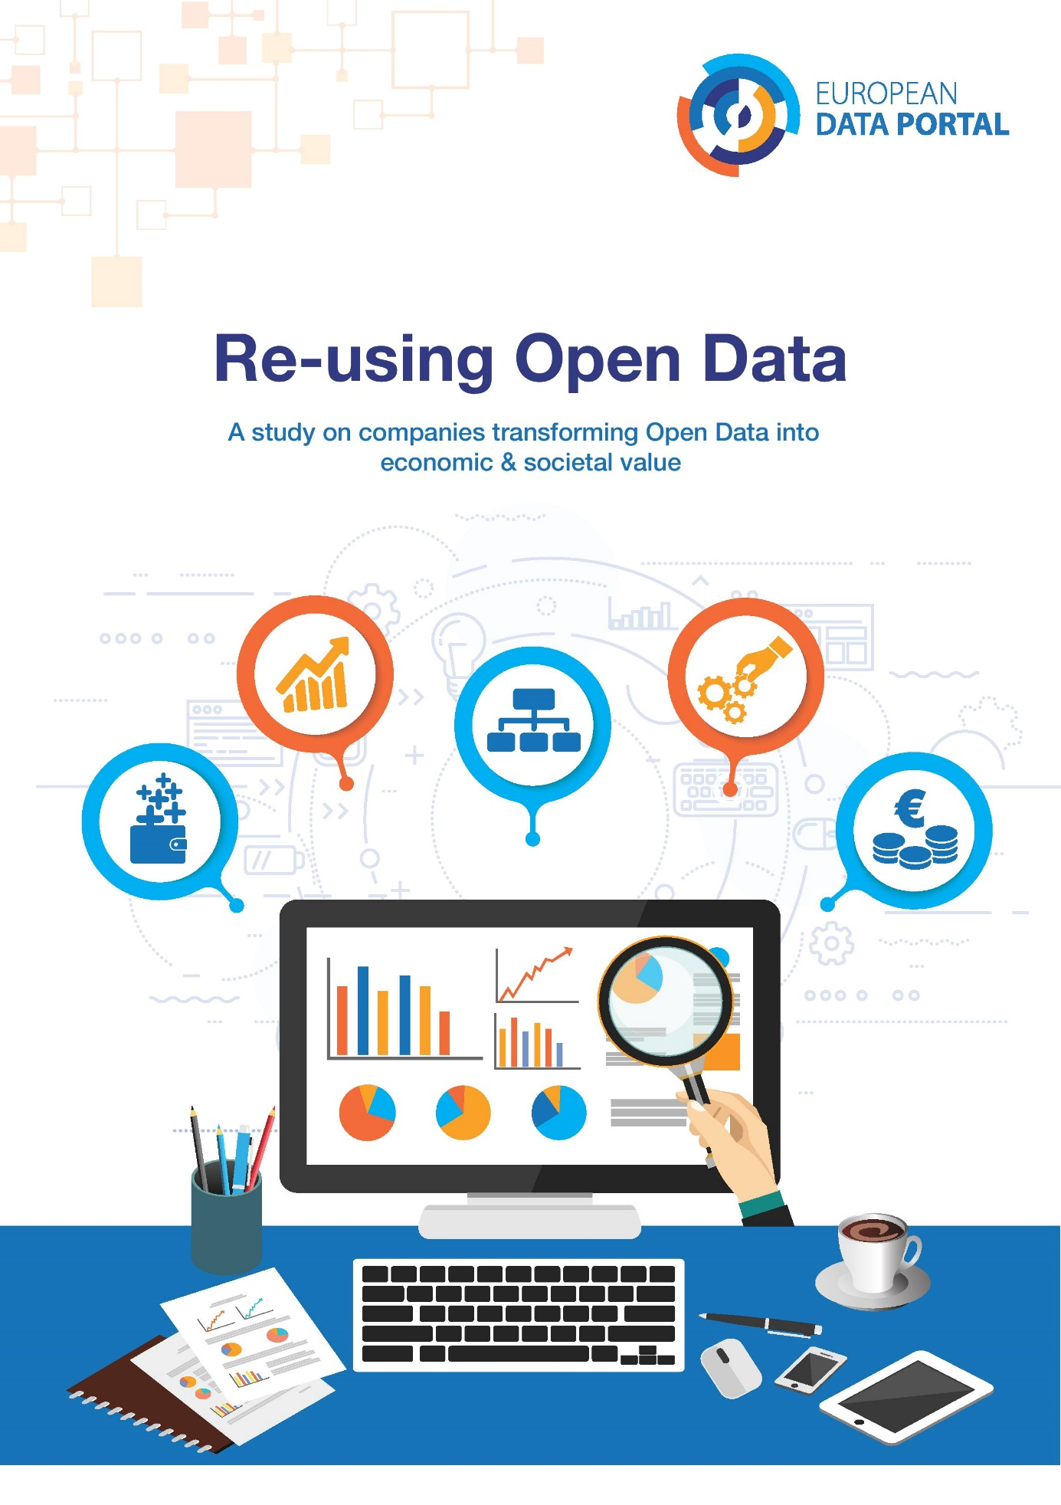
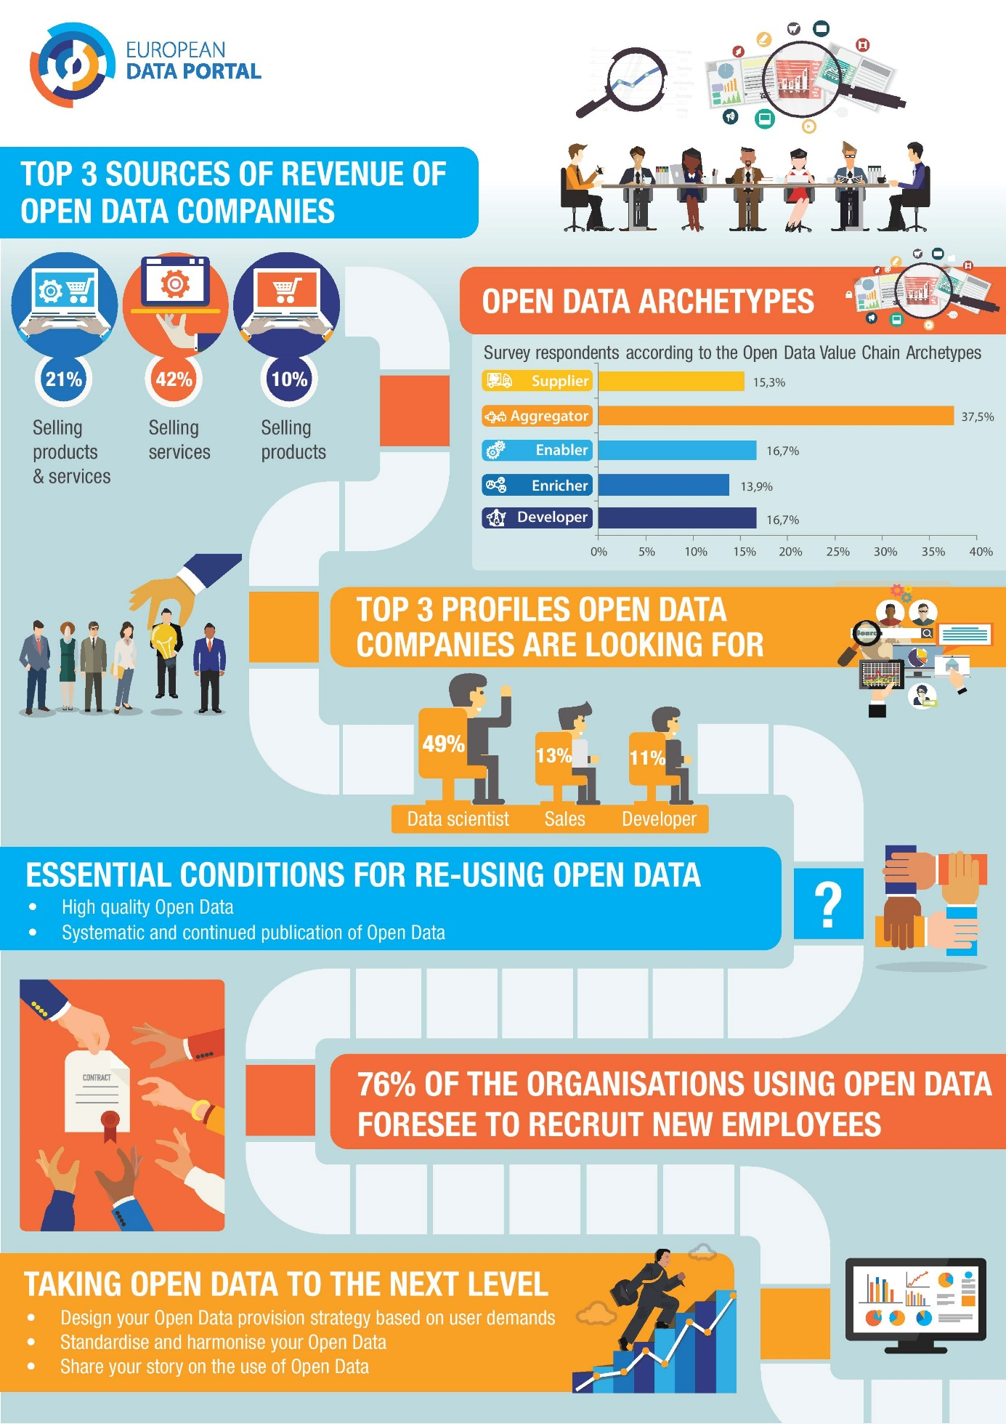
Recent EDP reports – Re-using Open Data
https://www.europeandataportal.eu/en/highlights/how-open-data-being-re-used-europe

Slide 13
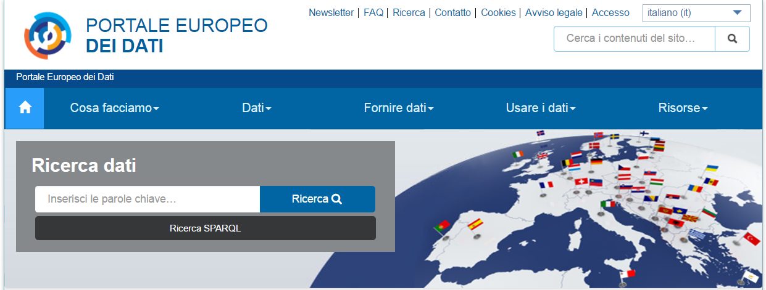



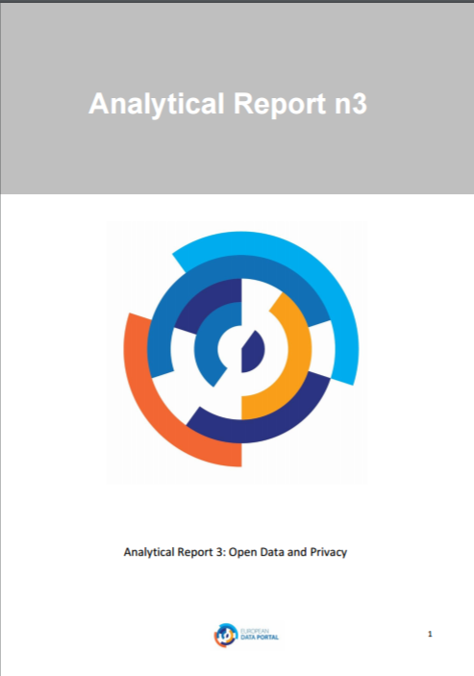


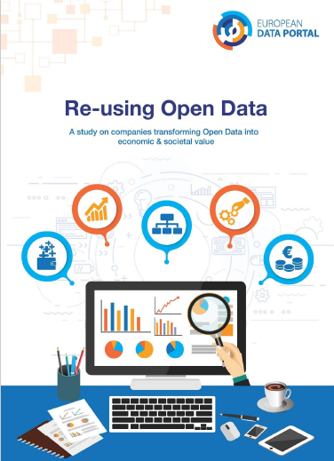


Data, learning resources, studies and uses cases
Creating Value Through Open Data
Open Data & Digital Transformation
Open Data & E-Skills
Open Data &
Privacy
Open Data &
Cities
Open Data Maturity in Europe
Re-using
Open Data
Recommendations for Open Data Portals
Barriers in working with Open Data
data.europa.eu/europeandataportal

